Slide 1
Good Morning!

Slide 2

Weathering the Storm
An Incident Response Tabletop Exercise

Slide 3
Learn about the different teams in information security and how they work together in an interactive exercise.

Slide 4

Company Profile
Apptastic.io
Headquartered in New York, NY
890 Employees
Goal is to build a fully immersive experience in a futuristic cityscape in the metaverse. Users connect to the experience using HololensTM technology and interact with each other using social credits.
Company wants to rebrand to better align name with mission. It’s technology stack is hosted primarily in the cloud on AWS.

Slide 5
Company Profile
Introducing a new immersive virtual experience by Apptastic.io

Slide 6

Meet The Team
Picture of the teacher here
[Teacher’s Name]
Chief Information Security Officer
Apptastic

Slide 7



Meet The Team
Security Operations
Security Engineering
Governance, Risk and Compliance

Slide 8
Guidelines for the Exercise
Please stop me and ask questions. We are here to learn.
After each event (“inject”), we will have a certain number of turns.
Talk amongst yourselves and share information on your cards.
Ask questions and have fun!

Slide 9
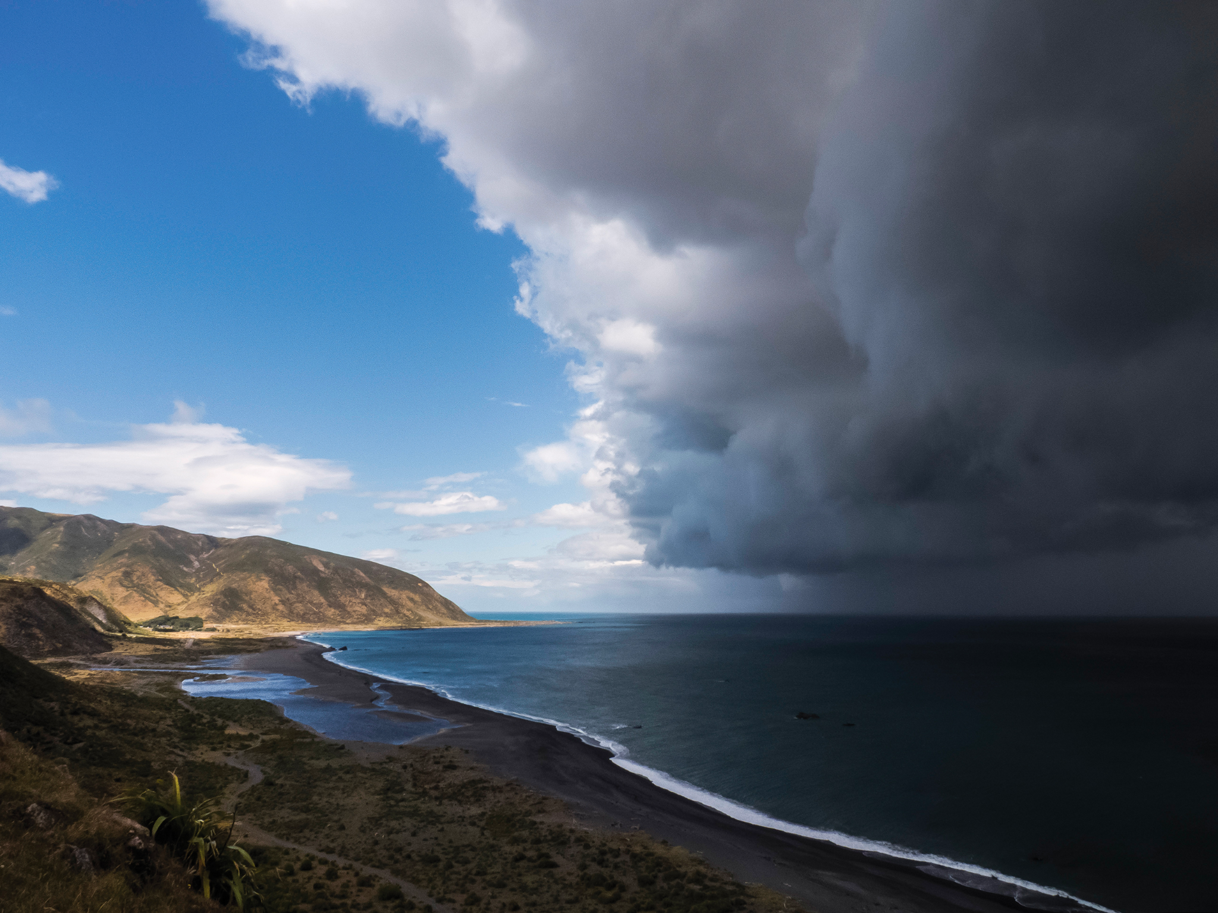
Are we ready??

Slide 10
Nov 23, 2023 @ 20:03:00 UTC
Security Operations receives an email from AWS Support.

Slide 11
Nov 23, 2023 @ 20:03:00 UTC - The AWS Email
Dear AWS Customer,
As part of our AWS Shield Advanced offering, we noticed a significant volume of traffic against your public Elastic IPs in 226692608800. This is usually indicative of a DDOS attack. We recommend you block all IP addresses identified in the WAF logs.
109.201.133.100
109.70.100.65
185.220.100.243
Please create an AWS Support ticket if you would like to chat with an agent in real time.

Slide 12
Nov 23, 2023 @ 21:15:00 UTC
Security Operations receives an alert from one of the company’s Intrusion Detection System (IDS).

Slide 13
Nov 24, 2023 @ 06:02:44 UTC
Several teams notify security@apptastic.io saying that several applications are non-responsive. Application Security team also receives alerts from PagerDuty.

Slide 14
Nov 24, 2023 @ 12:05:30 UTC
More teams notify security@apptastic.io saying that many of the company’s internal and external applications are non-responsive. There are some trending topics on social media that report the same.

Slide 15
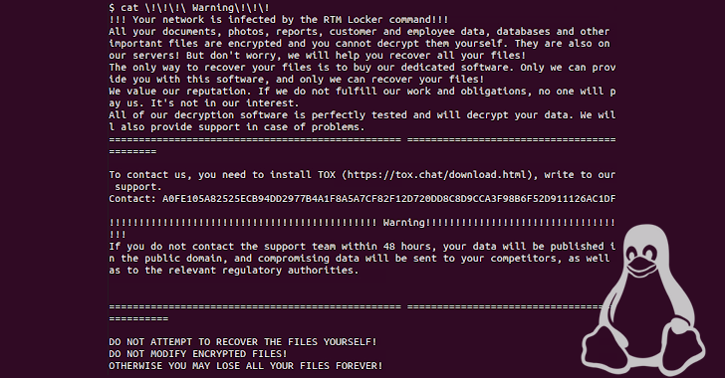
Nov 24, 2023 @ 12:10:43 UTC

Slide 16
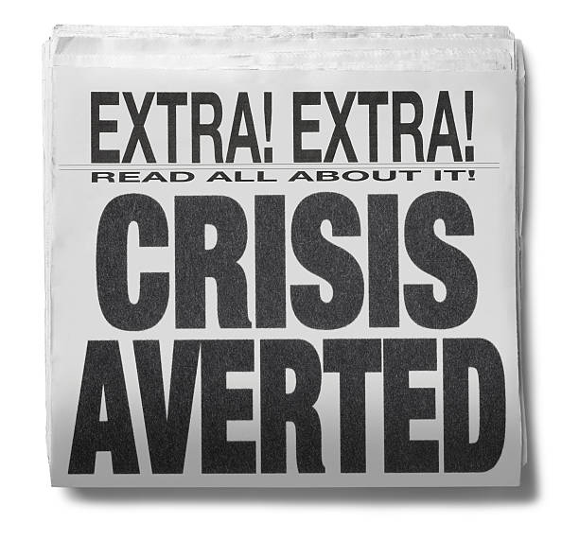

Slide 17
